Slide 1
Inventory Management System 22AprEnable1 Jordan Lee

Slide 2
Introduction
MVP: Have an application with basic create, read, update, delete functionality
-Three components: Customers, items, orders
Scope
- Feature-branch model, Jira project management board, Risk assessment, relational databases modelled using ERD

Slide 3
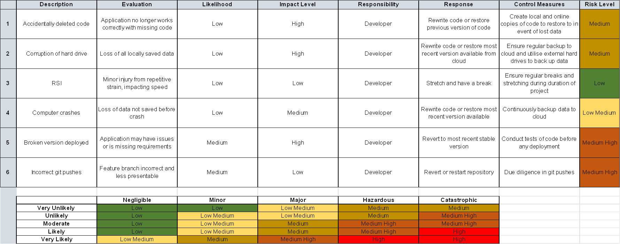
Risk Assessment

Slide 4
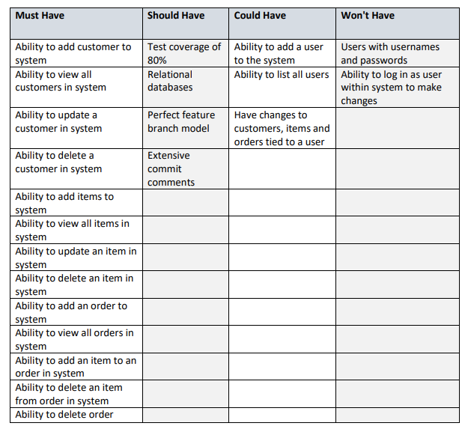
MoSCoW

Slide 5
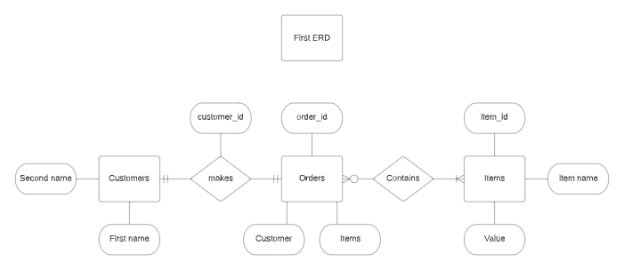
First ERD

Slide 6
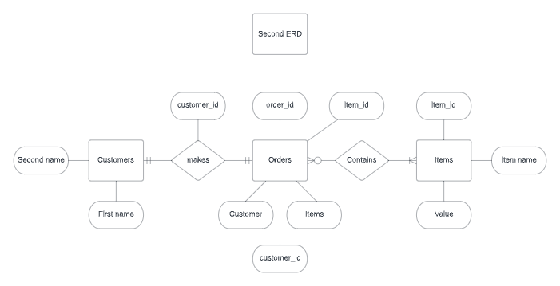
Second ERD

Slide 7
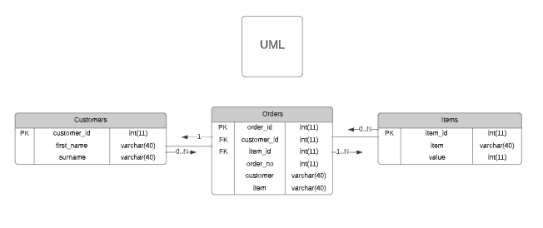

UML

Slide 8
Sprints
1 Sprint
Epics – Customer, Item, Order
User Stories – 4-6 for each epic covering MVP

Slide 9
User Stories
What is a user story?
Adding them to epic
Some examples…

Slide 10
Tasks
What is a task?
Some examples…

Slide 11
GitHub
Main branch
Dev branch
Feature branch – Customer, Item, Order
Commit messages

Slide 12
Version Control
Let’s look at some version control..

Slide 13
CRUD
Create, Read, Update, Delete
How was it tested?
Were user stories fulfilled?

Slide 14
Unit Testing
What I managed to test
What I didn’t manage to test

Slide 15
Test Coverage
How much test coverage achieved? Let’s take a look
Industry standard is 80%

Slide 16
Sprint Review
What went well
What didn’t go well
What goals took too long
What goals were missed

Slide 17
Live Demo

Slide 18
Developer Journey
Skills needed for project
- GitRepo, SQL, Java, JDBC
What have I learned? - A lot!
How it has allowed me to complete project

Slide 19
Ending comments and questions
Thank you for watching my presentation

